Slide 1
REST API Design
Crystal Tenn
Crystal.Tenn@microsoft.com

Slide 2
What is a REST API?
Notes:
Benefits of containers include: Density and agility, enabling agile application development and deployment
Don’t mistake Hyper-V container with a VM – containers are much more agile (deploy with a flip of the bits, etc.)

Slide 3

What is a REST API?
REST is acronym for REpresentational State Transfer.
First presented by Roy Fielding in 2000.
An architectural style for defining APIs

Slide 4
REST API Concepts
Resource - any information that can be named
A resource is identified by a resource identifier
The state of resource at any particular timestamp is known as resource representation
Resource representations should be self-descriptive
Resource methods are used to perform the desired state transition
Notes:
Double check the ‘state’ in red above. I added that to the description from https://restfulapi.net/
Pretty sure it’s right but please double check!

Slide 5
REST Architectural Constraints
Client-server
Separation of concerns
Independently scalable
Notes:
Directly from the inventor’s dissertation https://www.ics.uci.edu/~fielding/pubs/dissertation/rest_arch_style.htm

Slide 6
REST Architectural Constraints
Stateless
Each request from client to server must contain all of the information necessary to understand the request, and cannot take advantage of any stored context on the server.
Session state is therefore kept entirely on the client.
Notes:
Directly from the inventor’s dissertation https://www.ics.uci.edu/~fielding/pubs/dissertation/rest_arch_style.htm

Slide 7
REST Architectural Constraints
Cacheable
Being stateless means more client-server interactions
Cacheability to help alleviate network overload
Response to a request must explicitly state if it is cacheable or not
Notes:
Directly from the inventor’s dissertation https://www.ics.uci.edu/~fielding/pubs/dissertation/rest_arch_style.htm

Slide 8
REST Architectural Constraints
Uniform interface
Generality
Improved visibility
Decoupling
Independent evolvability
Relies on 4 key constraints…
Notes:
Directly from the inventor’s dissertation https://www.ics.uci.edu/~fielding/pubs/dissertation/rest_arch_style.htm

Slide 9
Constraints for a uniform interface
Identification of resources;
Manipulation of resources through representations;
Self-descriptive messages; and,
Hypermedia as the engine of application state (HATEOAS).
Notes:
Directly from the inventor’s dissertation https://www.ics.uci.edu/~fielding/pubs/dissertation/rest_arch_style.htm

Slide 10
What is the difference between a REST and Web API? What makes it RESTful?

Slide 11
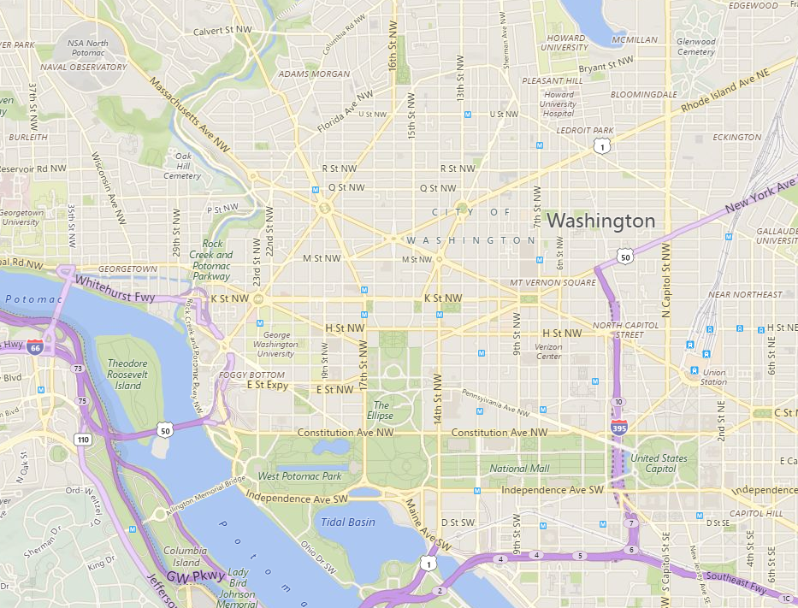

What is the difference between a REST and Web API? What makes it RESTful?
A Web API is like printing a map before a journey and trying to follow it. The map doesn’t adapt to, say, traffic jams.
A REST API on the other hand is like navigating by following street signs rather than a pre-printed map.

Slide 12
What is the difference between a REST and Web API? What makes it RESTful?
In Web API (RPC), what you can do with the API is described in documentation.
In REST APIs, the client discovers where it can go and what it can do on-the-fly based on what the server tells the client. This navigation by links and operations (together known as hypermedia) is key for an API to be RESTful.
In fact, ‘hypermedia as the engine of application state’ (HATEOAS) is a non-negotiable constraint of the RESTful architectural pattern.
This provides decoupling where the client does not need to know how to use a given RESTful API. In otherwords, as the API changes, the client automatically adapts because it will simply follow the (new) directions from the server.

Slide 13
What are all of the REST API request types?

Slide 14
What are all of the REST API request types?
Over HTTP, these are:
GET
POST
PUT
DELETE
BUT…

Slide 15
What are all of the REST API request types?
Merely publishing these requests does not make an API RESTful.
To be RESTful, the server’s response to these requests should guide the client – via hypermedia - how to invoke state change on the resource.
In other words, say a client makes a GET call for a resource (e.g. a toaster). The response from the server should give hyperlinks (i.e. URLs) to operations possible on the resource (e.g. URL to turn the toaster on, URL to adjust the toaster’s heat setting, etc). The client can then on-the-fly follow these links to invoke change in state of the resource it’s dealing with. This is hypermedia (the links) driving application state change, i.e. HATEOAS.
So the GET, POST, PUT, and DELETE are important but not the whole story.

Slide 16
What are REST APIs used for?
Notes:
Benefits of containers include: Density and agility, enabling agile application development and deployment
Don’t mistake Hyper-V container with a VM – containers are much more agile (deploy with a flip of the bits, etc.)

Slide 17
What are REST APIs used for?
Advantages: (from the guy who came up with REST)
emphasizes scalability of component interactions,
generality of interfaces,
independent deployment of components, and intermediary components to reduce interaction latency,
enforce security, and
encapsulate legacy systems
Also (from my understanding)
Decoupling client and server
Designing clients that automatically adapt to API changes (remember they navigate by the links they see after each request, rather than following a pre-written API description as in with traditional RPC APIs).
Providing APIs as a business service (e.g. charge per API call).
Protecting the backend by implementing load-balancing at the API layer (e.g. Azure API Gateway <- check this I’m only guessing!)

Slide 18
What are naming conventions for REST APIs?
Notes:
Benefits of containers include: Density and agility, enabling agile application development and deployment
Don’t mistake Hyper-V container with a VM – containers are much more agile (deploy with a flip of the bits, etc.)

Slide 19
What are naming conventions for REST APIs?
rewrewrwer asdfasfdsadfarallel and high-performance computing (HPC) applications efficiently in the cloud.

Slide 20
What are naming conventions for REST API paths?
Notes:
Benefits of containers include: Density and agility, enabling agile application development and deployment
Don’t mistake Hyper-V container with a VM – containers are much more agile (deploy with a flip of the bits, etc.)

Slide 21
What are naming conventions for REST API paths?
rewrewrwer asdfasfdsadfarallel and high-performance computing (HPC) applications efficiently in the cloud.

Slide 22
How do I create a REST API?
Notes:
Benefits of containers include: Density and agility, enabling agile application development and deployment
Don’t mistake Hyper-V container with a VM – containers are much more agile (deploy with a flip of the bits, etc.)

Slide 23
How do I create a REST API?
Dunno how to in .NET ☹ but in Java we use Swagger and Spring Boot
If you want a Java/Spring/Swagger demo I can make one!!

Slide 24
How do I create a REST API in MVC?
Notes:
Benefits of containers include: Density and agility, enabling agile application development and deployment
Don’t mistake Hyper-V container with a VM – containers are much more agile (deploy with a flip of the bits, etc.)

Slide 25
How do I create a REST API in MVC?
rewrewrwer asdfasfdsadfarallel and high-performance computing (HPC) applications efficiently in the cloud.

Slide 26
How do I create a REST API in MVP Web Forms?
Notes:
Benefits of containers include: Density and agility, enabling agile application development and deployment
Don’t mistake Hyper-V container with a VM – containers are much more agile (deploy with a flip of the bits, etc.)

Slide 27
How do I create a REST API in MVP Web Forms?
rewrewrwer asdfasfdsadfarallel and high-performance computing (HPC) applications efficiently in the cloud.

Slide 28
How do I create a REST API in Web Forms?
Notes:
Benefits of containers include: Density and agility, enabling agile application development and deployment
Don’t mistake Hyper-V container with a VM – containers are much more agile (deploy with a flip of the bits, etc.)

Slide 29
How do I create a REST API in Web Forms?
rewrewrwer asdfasfdsadfarallel and high-performance computing (HPC) applications efficiently in the cloud.

Slide 30
Demo
Create a REST API
Notes:
End 37 mins

Slide 31
Building REST APIs
Laurie Atkinson
Senior Consultant
Premier Developer Practice

Slide 32
Objectives
Agenda
Why REST?
Properties of a RESTful Architecture
Building RESTful services with both NodeJS and ASP.NET Web API
Building a client using Angular
Hypermedia
Versioning
OData
Objectives:
Understand the REST architectural style, its benefits and how it fits into modern application development

Slide 33









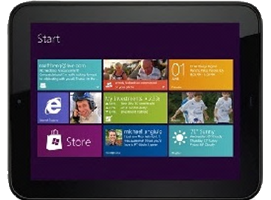




Why build REST APIs?
Broad range of clients from disparate platforms can consume HTTP services
Notes:
Devices need to evolve independent of the services
May be implemented via native apps rather than a web app UI
Efficiency and performance are a big deal on devices
Overall network is inconsistent and unreliable

Slide 34
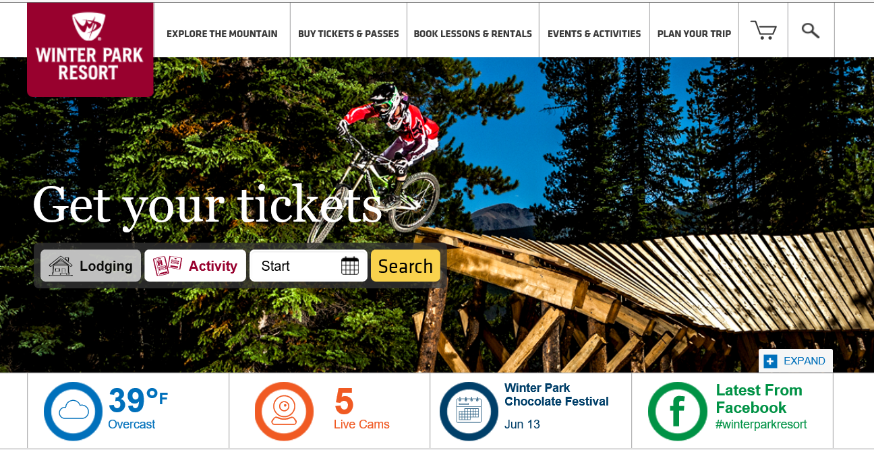
Why build REST APIs?
Notes:
Heterogeneous interoperability (1 web page that is getting data from different sources.)
Search: Bing
Ads: ad vendor
Manage Comments: Discus
Share: FB, Twitter

Slide 35
Origins
“Architectural Styles and the Design of Network-based Software Architectures”
by Roy Fielding in 2000
Notes:
Let's define some terms first

Slide 36
Benefits of REST
Scalability
Reliability
Simplicity
Portability
Evolvability
Visibility
Heterogeny
Manageability
Efficiency
Performance
Notes:
BENEFITS
Scalability-limits the complexity between components in a distributed system. Also allows for horizontal scaling when needed
Evolvability-ability to evolve parts of the system independently
Heterogeny-ability to operate between systems regardless of language or platform
Reliability-rich compensation strategies for failure
Visibility-allows monitoring and without needing to see the hidden or proprietary implementation details
Efficiency-proxy servers and caching to enable to move this processing off of your server as well as the managing of shared state.
Performance-response to the client can be improved based on these same features and techniques
Manageability-possible since the actions are performing in a highly consistent way, so management tools can have a much greater impact.
Draw these somewhere in the room, so that when we go through each constraint we can identify which benefits are addressed

Slide 37
How do you define it?
Notes:
Whiteboard.
What must be true to make a service RESTful?
Use cases where a REST service makes sense?
Poll the audience

Slide 38

What is !REST?
An architecture that is not SOAP
Not a URI style
Not a standard
In theory - Not HTTP
Notes:
REST is an architectural style and SOAP is an implementation detail. There are no RESTful systems using SOAP. But, to make sure we understand our terms, we should actually compare to RPC.
In REST the semantics of the interaction are not abstracted away at all. They are made a key part of the design
Just because you build an HTTP-based system making use of HTTP verbs does not mean that you have a RESTful system
While current RESTful systems are built using HTTP, that does not make it a RESTful service
Because of the success of Rails and ASP.NET MVC which enforce a URL structure, developers may think that this in itself makes a RESTful architecture. So, don't become hyper-focused on the URL style.

Slide 39
Compare REST and RPC
Feature | RPC | REST
Contract | Service and its operations | Uniform interface
Actions | Specified separately using something like WSDL | Specified by the uniform interface. Hypermedia used to move through the workflow
Errors | Specified out of band | Specified by the uniform interface
Caching | Optional and not guaranteed | Supported at each layer
URLs | Client knows the URL prior to deployment | Server determined.
Inputs and Outputs | Tied to underlying runtime types | Tied to the media type specification
Protocol | Multiple protocols | Tied to the protocol of the uniform interface
Notes:
Who is building SOAP services now?
Inputs and outputs: functions include parameters that are defined by the type-system. With REST no formal type system for parameters
Protocols-WCF can run on top of HTTP, TCP, MSMQ by configuration changes only.

Slide 40
What about HTTP?
HTTP provides a uniform interface
The uniform interface includes all the REST constraints
So, in practice…
REST is all about HTTP
Notes:
http://www.w3.org/Protocols/History.html
http://www.w3.org/Protocols/HTTP/1.1/draft-ietf-http-v11-spec-01.html ← note the author
http://www.w3.org/Protocols/History.html
http://www.ics.uci.edu/~fielding/pubs/dissertation/rest_arch_style.htm

Slide 41

What is REST?
REpresentational State Transfer
Architectural style for service design
Way of thinking
Resource based
6 Constraints
Uniform interface
Stateless
Client-Server
Cacheable
Layered System
Code-on-demand
Notes:
Roy Fielding – part of doctoral dissertation – first introduced in 2000.
He was one of the original architects of the world wide web and he was describing how the web was intended to work.
A virtual state machine where progress is made via links
Resource-based (based on representations passed back and forth between client and server)
Intended for long-lived network-based applications

Slide 42
Basic Concepts
Notes:
Let's define some terms first

Slide 43
What is a Resource?
A concept, a thing, a noun
Addressable by URI
Multiple URIs can refer to the same resource
Expressed as a representation
Separate from the representation
Notes:
A resource is the concept that the author wishes to identify rather than any specific value.
Maps a named concept to a set of entities over time.
Many to many relationship between named concepts and entities
The relationship may be consistent over time or it may change frequently
Accessible using a noun rather than a verb.
Representation can be in different ways to represent the same resource.
Typically represents data structure (entity)
File
Streaming video
Device: Printers or IoT (wireless garage door opener)
Application behavior…

Slide 44
What is a Resource?
Children
Entity
Katrina
Youngest
Child
Mappings
Oldest
Child
Resource
Kevin
Katrina
Kevin
Notes:
A resource is a concept, a stable concept in the system.
What changes over time is the mapping between resources and entities.
Maybe our system is for a book store and the resource is the top seller. The entity will change over time.
5.2.1.1 Resources and Resource Identifiers
The key abstraction of information in REST is a resource. Any information that can be named can be a resource: a document or image, a temporal service (e.g. "today's weather in Los Angeles"), a collection of other resources, a non-virtual object (e.g. a person), and so on. In other words, any concept that might be the target of an author's hypertext reference must fit within the definition of a resource. A resource is a conceptual mapping to a set of entities, not the entity that corresponds to the mapping at any particular point in time.
More precisely, a resource R is a temporally varying membership function M_{R}(t), which for time t maps to a set of entities, or values, which are equivalent. The values in the set may be resource representations and/or resource identifiers. A resource can map to the empty set, which allows references to be made to a concept before any realization of that concept exists -- a notion that was foreign to most hypertext systems prior to the Web [61]. Some resources are static in the sense that, when examined at any time after their creation, they always correspond to the same value set. Others have a high degree of variance in their value over time. The only thing that is required to be static for a resource is the semantics of the mapping, since the semantics is what distinguishes one resource from another.
For example, the "authors' preferred version" of an academic paper is a mapping whose value changes over time, whereas a mapping to "the paper published in the proceedings of conference X" is static. These are two distinct resources, even if they both map to the same value at some point in time. The distinction is necessary so that both resources can be identified and referenced independently. A similar example from software engineering is the separate identification of a version-controlled source code file when referring to the "latest revision", "revision number 1.2.7", or "revision included with the Orange release."
This abstract definition of a resource enables key features of the Web architecture. First, it provides generality by encompassing many sources of information without artificially distinguishing them by type or implementation. Second, it allows late binding of the reference to a representation, enabling content negotiation to take place based on characteristics of the request. Finally, it allows an author to reference the concept rather than some singular representation of that concept, thus removing the need to change all existing links whenever the representation changes (assuming the author used the right identifier).

Slide 45
Resource Identifier
Identifies a resource
Book with ISBN of 27391290
http://myapi.com/books/27391290
Resource
Resource Identifier
Notes:
In HTTP, the Resource Identifier is the URL
REST uses a resource identifier to identify the particular resource involved in an interaction between components. REST connectors provide a generic interface for accessing and manipulating the value set of a resource, regardless of how the membership function is defined or the type of software that is handling the request. The naming authority that assigned the resource identifier, making it possible to reference the resource, is responsible for maintaining the semantic validity of the mapping over time (i.e., ensuring that the membership function does not change).
Traditional hypertext systems [61], which typically operate in a closed or local environment, use unique node or document identifiers that change every time the information changes, relying on link servers to maintain references separately from the content [135]. Since centralized link servers are an anathema to the immense scale and multi-organizational domain requirements of the Web, REST relies instead on the author choosing a resource identifier that best fits the nature of the concept being identified. Naturally, the quality of an identifier is often proportional to the amount of money spent to retain its validity, which leads to broken links as ephemeral (or poorly supported) information moves or disappears over time.

Slide 46
Resource Identifier
Resource
Resource identifier
Children
Entity
/children
Katrina
Youngest
Child
/children/youngest
Oldest
Child
/children/oldest
Kevin
Katrina
/children/katrina
Kevin
/children/kevin
Notes:
Identifier is something that identifies a resource
Should not change very frequently
The mapping to the entity may change quite frequently

Slide 47





Representation
View of the state of a resource at an instant in time.
<Person>
<Id>72430</Id>
<FirstName>Fred</FirstName>
<LastName>Flinstone</LastName>
</Person>
{
"Id": "72430",
"FirstName": "Fred",
"LastName": "Flinstone"
}
Data format of a representation is its media type.
Notes:
REST components perform actions on a resource by using a representation to capture the current or intended state of that resource and transferring that representation between components. A representation is a sequence of bytes, plus representation metadata to describe those bytes. Other commonly used but less precise names for a representation include: document, file, and HTTP message entity, instance, or variant.
Control data defines the purpose of a message between components, such as the action being requested or the meaning of a response. It is also used to parameterize requests and override the default behavior of some connecting elements. For example, cache behavior can be modified by control data included in the request or response message.
Depending on the message control data, a given representation may indicate the current state of the requested resource, the desired state for the requested resource, or the value of some other resource, such as a representation of the input data within a client's query form, or a representation of some error condition for a response. For example, remote authoring of a resource requires that the author send a representation to the server, thus establishing a value for that resource that can be retrieved by later requests. If the value set of a resource at a given time consists of multiple representations, content negotiation may be used to select the best representation for inclusion in a given message.
The data format of a representation is known as a media type [48]. A representation can be included in a message and processed by the recipient according to the control data of the message and the nature of the media type. Some media types are intended for automated processing, some are intended to be rendered for viewing by a user, and a few are capable of both. Composite media types can be used to enclose multiple representations in a single message.
The design of a media type can directly impact the user-perceived performance of a distributed hypermedia system. Any data that must be received before the recipient can begin rendering the representation adds to the latency of an interaction. A data format that places the most important rendering information up front, such that the initial information can be incrementally rendered while the rest of the information is being received, results in much better user-perceived performance than a data format that must be entirely received before rendering can begin.
For example, a Web browser that can incrementally render a large HTML document while it is being received provides significantly better user-perceived performance than one that waits until the entire document is completely received prior to rendering, even though the network performance is the same. Note that the rendering ability of a representation can also be impacted by the choice of content. If the dimensions of dynamically-sized tables and embedded objects must be determined before they can be rendered, their occurrence within the viewing area of a hypermedia page will increase its latency.

Slide 48
REST Data Elements
Data Element | Web Examples
Resource | the intended conceptual target of a hypertext reference
Resource Identifier | URL
Representation | HTML document, JPEG image
Representation Metadata | media type, last-modified time
Resource Metadata | source link, alternates
Control Data | if-modified-since, cache-control

Slide 49
Quiz
Notes:
Execute an HTTP call to a public web site (portal.azure.com) using Chrome and then look at Settings request and ask what is:
the resource
the resource identifier
the representation
representation metadata
resource metadata
control data
media type

Slide 50
Demo #1
Content Negotiation
Notes:
Run completed Web API app.
Demos\ChildrenDemo
GET http://localhost/children/katrina
Accept: application/json
GET http://localhost/children/katrina
Accept: application/xml
GET http://localhost/children/katrina
Accept: image/png
Then, walk through with students to build WebAPI from scratch
Note: Also, include the following for camel case:
var json = config.Formatters.JsonFormatter;
json.SerializerSettings.Formatting = Newtonsoft.Json.Formatting.Indented;
json.SerializerSettings.ContractResolver = new CamelCasePropertyNamesContractResolver();

Slide 51
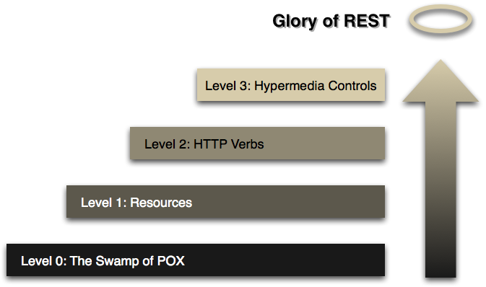
Richardson's Maturity Model
http://martinfowler.com/articles/richardsonMaturityModel.html
Notes:
These are the steps to get to a RESTful architecture. In order to be a RESTful service, it must be at level 3.
http://martinfowler.com/articles/richardsonMaturityModel.html
Level 0: Use HTTP as the transport system - plain old XML (POX) back and forth to one service endpoint. RPC wrapped in an HTTP message envelope.
It is all POSTs or GETs from the client for the calls.
Level 1: Multiple service endpoints or resources. Still all POSTs or GETs
Level 2: Use GET for safe operations (call multiple times, can be cached). Use PUT/POST for changing the state of the resource.
Server responds with HTTP status codes.
Level 3: HATEOAS (Hypertext As The Engine Of Application State)

Slide 52
So, how do we get there?
How does Fielding approach it?
Identify forces that will prevent our system from being broadly usable
Apply constraints to incrementally shape the system
Map the domain of the business onto the domain of the architecture
Business Domain
Architectural Domain
RPC
REST
Notes:
http://www.ics.uci.edu/~fielding/pubs/dissertation/rest_arch_style.htm
There are two common perspectives on the process of architectural design, whether it be for buildings or for software.
The first is that a designer starts with nothing--a blank slate, whiteboard, or drawing board--and builds-up an architecture from familiar components until it satisfies the needs of the intended system. For example, in software design. We have a limited set of requirements and we design our system based on those. Then, we get more requirements and we work to incorporate those. RPC leans this way since the requirements of the business and the requirements of the architecture are tightly coupled. It is designed and built with certain assumptions and in a controlled environment and then released, sometimes to find out about critical limitations that prevent them from being used outside of the environment in which they were designed.
The second is that a designer starts with the system needs as a whole, without constraints, and then incrementally identifies and applies constraints to elements of the system in order to differentiate the design space and allow the forces that influence system behavior to flow naturally, in harmony with the system. So, we identify at the beginning those forces that would prevent our system from being broadly usable. Then apply constraints to incrementally shape the system. So, the designer must map the domain of the business onto the domain of the architecture. This is the opposite with a Requirements-Driven approach.
Where the first emphasizes creativity and unbounded vision, the second emphasizes restraint and understanding of the system context. REST has been developed using the latter process.

Slide 53
8 Fallacies of Distributed Computing
The network is reliable
Latency is zero
Bandwidth is infinite
The network is secure
Topology doesn't change
There is one administrator
Transport cost is zero
The network is homogeneous
Notes:
First, Identify forces that will prevent our system from being broadly usable.
Assumptions developers tend to make when building distributed applications.
REST attempts to address these fallacies.
http://en.wikipedia.org/wiki/Fallacies_of_distributed_computing
Network reliability: Many problems can occur to interrupt the connection to the network.
Latency: Think about users on the other side of the planet from your server. Or what about mobile devices that run on flaky networks.
Bandwidth: How much can we fit over our network pipe? And what is the cost to the client if they are operating over mobile network?
Security
Topology: DNS Names, IP addresses
Administration: How can we allow for people not intimately familiar with our application to administer it and diagnose errors?
Transport cost: Network cost must be accounted for
Homogeneous: All nodes on a network are not the same, particularly with the rise of mobile devices

Slide 54
REST Constraints
Notes:
Go through each constraint using Fielding's web page.
Identify which fallacy that constraint is addressing.

Slide 55
Client-Server Constraint
Client
Server
Request
Response

Slide 56
Client-Server Constraint
Disconnected system
Uniform interface is the connection
Client initiates by sending a message to the server
Server listens for incoming messages, does some processing, and returns a response to the client
Goal: Separation of concerns
Notes:
Clients know only about the servers and not other clients.
Servers do not know about clients
Influencing forces:
Security-can be scoped to the connections between clients and servers
Administration-can be scoped to the connections between clients and servers
Heterogeneous network-multiple clients of multiple platform types can connect and disconnect from the network without impacting system state of the server
Benefits:
Portability of clients
Scalability
Evolvability

Slide 57
Stateless Constraint
Client
Server
All state included here
Request
No state preserved here
Response

Slide 58
Stateless Constraint
Request
Client
Server
How: verb + content-type
Who: authentication
What: URI
When: preconditions
All state included here
No state preserved here
Self-descriptive message
Response
Notes:
Message contains enough information for the server to process it.
Any state must be maintained on the client
The representation carries the state.
That means the system is not dependent on synchronization between servers
Influencing forces:
Network reliability-storing state on the client and stateless communications to the server enable clients to recover from network errors
Network topology-clients and servers can come and go on the network without corrupting system state
Administration-visibility is improved with stateless client/server interaction, simplifying management
Benefits:
Visibility-is improved because a monitoring system does not have to look beyond a single request datum in order to determine the full nature of the request.
Reliability-if the server fails, the client can update it with the current state (which the client holds). If the client fails, it can get the last know representations from the server (typically from the last step in the workflow). Compare this to session state. If the client or server fails, the entire state of the workflow is unknown and you'll need to start over.
Scalability-is improved because not having to store state between requests allows the server component to quickly free resources, and further simplifies implementation because the server doesn't have to manage resource usage across requests. Having a shared session state makes the adding of more server nodes more difficult
The disadvantage is that it may decrease network performance by increasing the repetitive data (per-interaction overhead) sent in a series of requests, since that data cannot be left on the server in a shared context. In addition, placing the application state on the client-side reduces the server's control over consistent application behavior, since the application becomes dependent on the correct implementation of semantics across multiple client versions.

Slide 59
Self-descriptive Message - HOW
Verb
GET /api/persons/123 HTTP/1.1
Accept: application/json, text/xml
Host: localhost:8000
Authorization: Bearer 0b79bab50da…
If-None-Match: "289340187490"
Content-Type
Notes:
Note: Content-Type is not limited to pre-defined types such as XML and JSON.
Can define your own, such as application/vnd.contoso.myapp-v1+json
**Interpret requests generously
**Be strict with responses

Slide 60
Self-descriptive Message - WHO
GET /api/persons/123 HTTP/1.1
Accept: application/json, text/xml
Host: localhost:8000
Authorization: Bearer 0b79bab50da…
If-None-Match: "289340187490"
Authorization header

Slide 61
Self-descriptive Message - WHAT
URI
GET /api/persons/123 HTTP/1.1
Accept: application/json, text/xml
Host: localhost:8000
Authorization: Bearer 0b79bab50da…
If-None-Match: "289340187490"

Slide 62
Self-descriptive Message - WHEN
GET /api/persons/123 HTTP/1.1
Accept: application/json, text/xml
Host: localhost:8000
Authorization: Bearer 0b79bab50da…
If-None-Match: "289340187490"
Precondition

Slide 63



Cacheable Constraint
Representations from the server are cacheable on the client
Responses from the server must be declared as cacheable or non-cacheable
Notes:
If cached in the browser, you will see a 304 and no network traffic.
If cached on a proxy server, you'll see via in the header.
Demo Firefox on craigslist.org for 304 (first clear cache)
Demo Firefox on amazon.com for Via to show cloudfront.net (CDN)
Influencing forces:
Latency-caching can dramatically reduce latency by eliminating the need to make some requests
Bandwidth-local caching reduces the amount of data that needs to be consumed by the client while intermediary caching reduces the amount of data needed from the origin server
Transport cost-caching reduces the total number of network requests needed
Benefits
Efficiency
Scalability
Performance

Slide 64
ETags
Client
Request
Server
Response
← ETag header
Request
ETag test →
Same ETag?
Then, send 304
Response
Notes:
ETags are different from LastModified.
ETag does not have any information that the client can use to determine whether or not to make a request for that file again in the future. If ETag is all it has, it will always have to make a request. However, when the server reads the ETag from the client request, the server can then determine whether to send the file (HTTP 200) or tell the client to just use their local copy (HTTP 304). An ETag is basically just a checksum for a file that semantically changes when the content of the file changes.
The Expires header is used by the client (and proxies/caches) to determine whether or not it even needs to make a request to the server at all. The closer you are to the Expires date, the more likely it is the client (or proxy) will make an HTTP request for that file from the server.
Note: CacheCow.Server implements everything and is available for .NET via NuGet
Then, add the following to WebAPIConfig.cs:
config.MessageHandlers.Add(new CacheCow.Server.CachingHandler(config)); ← in memory caching

Slide 65
ETags
HTTP/1.1 200 OK
Content-Type: text/xml; charset=utf-8
Date: Wed, 17 June 2015 21;52:14 GMT
Etag: W/"289340187490"
Content-Length: 238
GET /api/persons/123 HTTP/1.1
Accept: application/json, text/xml
Host: localhost:8000
If-None-Match: "289340187490"
Notes:
Note: PUT and PATCH use this syntax:
If-Match: "289340187490"
returns: 412 Precondition Failed

Slide 66
Demo #2
Etags with CacheCow and WebAPI
Notes:
Demos\ChildrenDemo
NuGet package and code in WebAPIConfig.cs
Use POSTMAN to hit endpoint and take value from ETag in response header and include in If-Non-Match header with value in quotes.
If-None-Match "b0e5f8b969194d2b975dd03c2e0b4d8b"

Slide 67
Uniform Interface Constraint
Defines interface/contract between client and server
REST does not require HTTP, but that will be our implementation, so Uniform interface in HTTP means:
URIs are the resources identifiers
HTTP verbs are the actions
Notes:
Having the uniform interface has allowed the web to scale.
Influencing forces:
Network reliability-consistent semantics increases transparency, enabling clients and servers to more reliably handle failures
Network topology-providing a unified set of constraints governing how clients and servers communicate enables the system elements (including intermediates) to be created and evolve independently
Administration-general management tools can be introduced for optimizing the network
Heterogenous network-different client server platforms can easily interoperate
Benefits
Visibility
Evolvability

Slide 68
Guiding Principles of the Uniform Interface
Identification of Resources
Manipulation of Resources
Self-Descriptive messages
HATEOAS

Slide 69
Library Example
Given these requirements:
View all books in the library
View a specific book by id
Add a new book to the library
View books that are available to be checked out
Check out a book
Return a book

Slide 70
Identification of Resources
Books
Books (available)
Books (checked out)
Application States

Slide 71
Manipulation of Resources
new book
checkout book
Books
Books (available)
Books (checked out)
return book

Slide 72
Map resources to HTTP
POST
PUT or PATCH
new book
checkout book
Books
Books (available)
Books (checked-out)
api/books
api/books/available
api/books/checkedout
api/books/{id}
GET
GET
return book
GET
PUT or PATCH
Notes:
Self-descriptive messages: verb, URL, any media-types or other headers

Slide 73
HATEOAS
GET api/books
Include the following in the response:
Link to create a new book
Link to get available books
Link to get checked out books
GET api/books/{id}
Include the following in the response:
Link to check out this book
Link to return this book

Slide 74
Demo #3
Build REST API using NodeJS
Notes:
Run finished program and how to use POSTMAN.
Then, have students build from scratch with me.

Slide 75
Lab Steps - Installation
Install Node.js Tools for Visual Studio
https://nodejstools.codeplex.com/
Install Node
Install MongoDB on Windows
www.mongodb.org/downloads
Create a directory at his location: C:\data\db
Launch MongoDB (start the database process)
C:\Program Files\MongoDB\Server\3.0\bin\mongod

Slide 76
Lab Steps – Project Setup
Create a project in Visual Studio 2013
Blank Node.js Console App
Install npm package → express
Notes:
Make it in a folder with very short path. i.e. c:\Labs

Slide 77
Lab Steps – Hello world
app.js
var express = require("express");
var app = express();
var port = 8000;
app.get('/', function (req, res) {
res.send('hello from my API');
});
app.listen(port, function () {
console.log('Running on PORT: ' + port);
});

Slide 78
Lab Steps – Add the Model
Import data into MongoDB
From Visual Studio Solution Explorer, open folder in File Explorer
Open command prompt
"C:\Program Files\MongoDB\Server\3.0\bin\mongo" bookDB < sampleBooks.js
Add mongoose to project
npm install mongoose

Slide 79
Lab Steps – Add the Model
models\bookModel.js
var mongoose = require('mongoose');
var Schema = mongoose.Schema;
var bookModel = new Schema({
title: { type: String },
author: { type: String },
genre: { type: String },
checkedOut: { type: Boolean, default: false }
});
module.exports = mongoose.model('Book', bookModel);

Slide 80
Lab Steps – Add Routing
routes\bookRoutes
var express = require('express');
var routes = function (Book) {
var bookRouter = express.Router();
var bookController = require('../controllers/bookController')(Book);
bookRouter.route('/').get(bookController.get);
return bookRouter;
};
module.exports = routes;
Notes:
01bookRoutes

Slide 81
Lab Steps – Add Controller
controllers\bookController
See 01bookController for code
Run
Test using POSTMAN

Slide 82
Lab Steps – Add Routing for specific book
routes\bookRoutes
See 02bookRoutes for code
Run
Test using POSTMAN

Slide 83
Hypermedia
Decouple the client and server by reducing the number of URLs that the client needs to know
Instead the client needs to know only the single entry point into the service and dereference links to access other resources in the system
This allows flexibility of the server to adapt its URL structure
Notes:
Think about going to a news site home page and navigating from there.

Slide 84
Hypermedia Controls
HTML already includes hypermedia controls
<a href=http://localhost/children/katrina rel="child">Katrina</a>
<form class="newChild" action="children" method="post">
First name <input name="firstName" />
Last name <input name="lastName" />
<input type="submit" value ="Add Child" />
</form>
JSON and XML do not and the author must include them
Notes:
rel defines the link relationship. This is what the client should need to understand, not derive semantic meaning from the href
In form tag, class is used to define the link relationship since form tag does not have a rel attribute.
action is the resource

Slide 85
Hypermedia Controls
<head>
<link rel="stylesheet" href="/Content/Site.css" />
<link rel="alternate" hreflang="de" href="/index+de" />
<link rel="alternate" media="print" href="/index_print" />
<link rel="next" href="/index/3" />
<link rel="prev" href="/index/1" />
</head>
<body>
<a href="/search" rel="search">Search</a>
. . .
</body>
Notes:
rel defines the link relationship. This is what the client should need to understand, not derive semantic meaning from the href

Slide 86
Hypermedia Links
Links assist the developers in showing them how to use the API
Creates a self-describing API
Links become the Application State
HATEOAS
Hypermedia As The Engine Of Application State

Slide 87
Common HATEOAS Links
Paging
Creating a new item
Retrieving associations
Performing actions

Slide 88
Links
{
"totalCount": 498,
"links": [
{ "href": http://localhost:8000/api/contacts?page=1,
"rel": prevPage" },
{ "href": http://localhost:8000/api/contacts?page=3,
"rel": nextPage" },
{ "href": http://localhost:8000/api/contacts,
"rel": insert" }
],
"results": [ . . . ]
}

Slide 89
Links
{
"links": [
{ "href": http://localhost:8000/api/books/123,
"rel": self" },
{ "href": http://localhost:8000/api/books/123/rating,
"rel": rating" }
],
"id": 123,
"name": "Pillars of the Earth",
"description": "Story of the building of a cathedral",
. . .
}

Slide 90
HAL
{
"_links": {
"self": { "href": "/orders" },
"curies": [{ "name": "ea",
"href": "http://example.com/docs/rels/{rel}",
"templated": true }],
"next": { "href": "/orders?page=2" },
"ea:find": { "href": "/orders{?id}", "templated": true },
},
"currentlyProcessing": 14,
"shippedToday": 20
}
Resource URI
Links to documentation
Links
Notes:
http://stateless.co/hal_specification.html
HAL is designed for building APIs in which clients navigate around the resources by following links.
There can be multiple links in the 'curies' section. They come with a 'name' and a templated 'href' which must contain the {rel} placeholder.
Links in turn can then prefix their 'rel' with a CURIE name. Associating the latest-posts link with the doc documentation CURIE results in a link 'rel' set to doc:latest-posts.
To retrieve documentation about the latest-posts resource, the client will expand the associated CURIE link with the actual link's 'rel'. This would result in a URL http://haltalk.herokuapp.com/docs/latest-posts which is expected to return documentation about this resource.

Slide 91
Collection+JSON
{ "collection":
{
"version": "1.0"
"href": http://localhost/api/contacts,
"items": [
"href": http://localhost/api/contacts/kevin,
"data": [
{"name": "full-name", "value": "Kevin Atkinson" }]],
"queries": [
{ "rel": "search", href": "./search", "data": [
{ "name": "search", "value": "" }]
}}
Notes:
https://github.com/collection-json/spec

Slide 92
ATOM
<?xml version="1.0" encoding="utf-8"?>
<feed xmlns="http://www.w3.org/2005/Atom">
<title>Example Feed</title>
<link href="http://example.org/"/>
<updated>2003-12-13T18:30:02Z</updated>
<author>
<name>John Doe</name>
</author>
<id>urn:uuid:60a76c80-d399-11d9-b93C-0003939e0af6</id>
<entry>
<title>Atom-Powered Robots Run Amok</title>
<link href="http://example.org/2003/12/13/atom03"/>
<id>urn:uuid:1225c695-cfb8-4ebb-aaaa-80da344efa6a</id>
<updated>2003-12-13T18:30:02Z</updated>
<summary>Some text.</summary>
</entry>
</feed>
Notes:
https://tools.ietf.org/html/rfc4287

Slide 93
Demo #4
Adding Hypermedia
Notes:
NodeJSDemo
02bookController
03bookRoutes
test with:
http://localhost:8000/api/books
http://localhost:8000/api/books/{id}
http://localhost:8000/api/books?genre=Historical Fiction

Slide 94
Layered System Constraint
Client
Server
Firewall
Gateway
Load Balancer
Server
Server
Notes:
Layers can be used to encapsulate legacy services and to protect new services from legacy clients, simplifying components by moving infrequently used functionality to a shared intermediary. Intermediaries can also be used to improve system scalability by enabling load balancing of services across multiple networks and processors.
The primary disadvantage of layered systems is that they add overhead and latency to the processing of data, reducing user-perceived performance. For a network-based system that supports cache constraints, this can be offset by the benefits of shared caching at intermediaries. Placing shared caches at the boundaries of an organizational domain can result in significant performance benefits. Such layers also allow security policies to be enforced on data crossing the organizational boundary, as is required by firewalls

Slide 95
Layered System Constraint
Client only knows the uniform interface
Separation of Concerns
Components should know only about components in the layer with which it is interacting
Notes:
Client does not need to know anything of the implementation of the server. Could be a cached response, could be going to the database to retrieve the result.
This could introduce latency, but can be mitigated with shared caches and load balancers.
Influencing forces:
Network topology-changing network components only impact those elements directly below
Security-layering enables intermediaries to be placed a t trust boundaries to manage security policies for components inside the boundary.
Benefits
Scale
Manageability
Think about the web. It has no centralized administrator. I manage my browser. It knows how to communicate with my corporate proxy, which is managed by my company. That proxy knows how to communicate with its ISP, which is managed by some telecom company.

Slide 96
Demo #5
Mashup Sample App
Relay Sample App
Notes:
Demos\MashupSample
Show code.
Run app.
Demos\RelaySample
Show code.
Run app.
Open cmd from folder with code and run curl specified in the ReadMe.txt

Slide 97
Code-on-demand (Optional Constraint)
Server could send logic (code) down to the client as a representation
Notes:
Client downloads and executes readymade features. This will greatly reduce visibility and could have a negative impact on cacheability and manageability and also have an impact on security as the client downloads and runs code that you do not control.
With the growth of JAX/HTML5 this may become more popular
Example: passive identity federation. Application delegates authentication to an identity provider like Google or Facebook. A response is sent with the expectation that the client will send an HTTP POST to another server. The way this works is the server returns a form along with some JavaScript code to automate submitting it. But, in case the browser has JavaScript disable, the server also returns instructions for the user to submit the form. So, for the clients that support code-on-demand the workflow is simplified, but others are given an alternate way to continue.
Benefit:
Simplicity

Slide 98
REST Constraints Summary
Understanding REST Constraints is required and will lead to a good API design
Building a stateless and scalable server is crucial
Use ETags whenever possible for caching
Use links wherever appropriate for self-describing messages
Be pragmatic rather than a purist.

Slide 99
REST Design Patterns

Slide 100
URI Structure
Not a requirement, but there are helpful patterns

Slide 101
URI Design
Lowercase
Substitute spaces with hyphens or underscores (pick one)
Use nouns in your routes

Slide 102
URI Design
No…
/api?action=getcomment&id=123
Yes…
/api/comments/123
/api/articles/5/photos/4/comments/1
Cacheable and Readable

Slide 103
URI Design
No…
/api/stories/orderby/date/limit/5
Yes…
/api/stories?orderby=date&limit=5
Don't filter via URI
Do filter by query string

Slide 104
Verbs
GET
retrieve whatever information (in the form of an entity) is identified by the Request-URI
Safe
Idempotent

Slide 105
Verbs
POST
server accepts the entity enclosed in the request as a new subordinate of the resource identified by the Request-URI
Safe
Idempotent

Slide 106
Verbs
PUT
enclosed entity is stored under the supplied Request-URI
If the Request-URI refers to an already existing resource it is a modified version of the one residing on the origin server
Otherwise, the server creates the resource for that URI
Safe
Idempotent

Slide 107
Verbs
PATCH
perform a partial update
Safe
Idempotent

Slide 108
Verbs
DELETE
requests that the origin server delete the resource identified by the Request-URI
Safe
Idempotent

Slide 109
HTTP Status Code Categories
Code | Meaning
1xx | Informational
2xx | Success
3xx | Redirection
4xx | Client error
5xx | Server error
Notes:
http://www.restapitutorial.com/httpstatuscodes.html

Slide 110
HTTP 2xx Status Codes
Code | Meaning
200 | OK | Resource returned
201 | Created | Resource created
204 | No content | Resource deleted
Notes:
GET or PUT (doing an update) can return a 200. Makes sense for the GET to return the resource, not always for a PUT

Slide 111
HTTP 3xx Status Codes
Code | Meaning
301 | Moved Permanently | Resource reorganized
302 | Found | Redirection for a specific object (i.e. search)
304 | Not modified | Resource was not changed
Notes:
302: The requested resource resides temporarily under a different URI. Since the redirection might be altered on occasion, the client SHOULD continue to use the Request-URI for future requests. This response is only cacheable if indicated by a Cache-Control or Expires header field.
304: If the client has performed a conditional GET request and access is allowed, but the document has not been modified, the server SHOULD respond with this status code. The 304 response MUST NOT contain a message-body, and thus is always terminated by the first empty line after the header fields.

Slide 112
HTTP 4xx Status Codes
Code | Meaning
400 | Bad request | invalid request
401 | Unauthorized | Request requires authentication
403 | Forbidden | Server refuses the request
404 | Not found | Resource not found
405 | Method not allowed | Verb used is not allowed for resource
409 | Conflict | Conflict with resource's current state
Notes:
401: The request requires user authentication. The response MUST include a WWW-Authenticate header field containing a challenge applicable to the requested resource. The client MAY repeat the request with a suitable Authorization header field.
403: The server understood the request, but is refusing to fulfill it. Authorization will not help and the request SHOULD NOT be repeated. If the request method was not HEAD and the server wishes to make public why the request has not been fulfilled, it SHOULD describe the reason for the refusal in the entity. If the server does not wish to make this information available to the client, the status code 404 (Not Found) can be used instead.
409: The request could not be completed due to a conflict with the current state of the resource. This code is only allowed in situations where it is expected that the user might be able to resolve the conflict and resubmit the request. The response body SHOULD include enough information for the user to recognize the source of the conflict. Ideally, the response entity would include enough information for the user or user agent to fix the problem; however, that might not be possible and is not required.
Conflicts are most likely to occur in response to a PUT request. For example, if versioning were being used and the entity being PUT included changes to a resource which conflict with those made by an earlier (third-party) request, the server might use the 409 response to indicate that it can't complete the request. In this case, the response entity would likely contain a list of the differences between the two versions in a format defined by the response Content-Type.

Slide 113
HTTP 5xx Status Codes
Code | Meaning
500 | Internal Server Error | Server encountered an unexpected condition which prevented it from fulfilling the request.
Notes:
Use this when there is nothing the client could do to prevent the error.

Slide 114
PUT or POST to create a new resource?
PUT / resource/123
Client
Server
201 Created
POST/ resource
201 Created
Include link to newly created resource in header
Notes:
http://stackoverflow.com/questions/630453/put-vs-post-in-rest
POST to a URL creates a child resource at a server defined URL.
PUT to a URL creates/replaces the resource in its entirety at the client defined URL.
PATCH to a URL updates part of the resource at that client defined URL.
Problem: How to ensure resource id is unique?
Resources can be created by multiple clients concurrently
Solution 1: let the client choose a unique id (e.g. GUID)
Solution 2: let the server compute the unique id.
Problem: Duplicate instances may be created if requests are repeated due to unreliable communication
Both PUT and POST can be used for creating.
You have to ask "what are you performing the action to?" to distinguish what you should be using. Let's assume you're designing an API for asking questions. If you want to use POST then you would do that to a list of questions. If you want to use PUT then you would do that to a particular question.
Great both can be used, so which one should I use in my RESTful design:
You do not need to support both PUT and POST.
Which is used is left up to you. But just remember to use the right one depending on what object you are referencing in the request.
Some considerations:
Do you name your URL objects you create explicitly, or let the server decide? If you name them then use PUT. If you let the server decide then use POST.
PUT is idempotent, so if you PUT an object twice, it has no effect. This is a nice property, so I would use PUT when possible.
You can update or create a resource with PUT with the same object URL
With POST you can have 2 requests coming in at the same time making modifications to a URL, and they may update different parts of the object.

Slide 115
Hypermedia
Links may be bookmarked by the client, but must fallback to the entry point if that link moves
Client should not try to interpret the meaning of the resource from the URI, but use the "rel" attribute

Slide 116
REST Antipatterns

Slide 117
Services define methods
Do not define more verbs or remote procedures such as /adduser or /updateuser
Do not include method names or remote procedures in the body of the HTTP request. Body should only contain resource state.

Slide 118
Using GET for everything
Verb | URI
GET | /api?method=addBook&title=Harry%20Potter
GET | /api?method=deleteBook&id=123
GET | /api?method=getBook&id=123
GET | /api?method=findBook&author=Rowling*
Notes:
Everything through GET
• Advantage: Easy to test from a Browser address bar (the “action” is represented in the resource URI)
• Problem: GET should only be used for read-only (= idempotent and safe) requests.
What happens if you bookmark one of those links?
• Limitation: Requests can only send up to approx. 4KB of data (414 Request-URI Too Long)

Slide 119
Using POST for everything
Trying to solve problem of sending an arbitrary amount of data like RPC-style with SOAP
POST is not idempotent and therefore unsafe
Cannot be cached

Slide 120
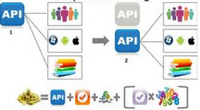
Versioning

Slide 121
Versioning
An API is an explicit contract with consumers
Developers write code against your method signatures and data shapes – changing it can break their applications
However, to move forward, your service must support enhancements and bug fixes
To do so, you must version your API to support changes without breaking clients
API versioning is not product versioning
Notes:
Thou shallt not break existing clients

Slide 122
The Right way?
No one right way
Can examine existing APIs for options
But, no single best option

Slide 123

When to Version?
When adding functionality…
Example: Add spending limit property to customer
Versioning not always required
Add the new property and clients can typically ignore it
Changing functionality
Removing or renaming resource content
Breaking change
Consider most appropriate versioning pattern

Slide 124
Versioning Examples
API | Pattern | Example
Tumbler | URI Path | http://api.tumbler.com/v2/user
Netflix | URI Parameter | http://api.netflix.com/catalog/titles/series/123?v=1.5
GitHub | Media Type | Content Type: application/vnd.github.1.param+json
Azure | Request Header | x-ms-version: 2015-01-01

Slide 125
URI Parameter Versioning Pattern
http://<host>/api/v3/order/1004
Popular approach
Include version number in URI path
Can support large-scale API changes
Everything after version number open to change

Slide 126
URI Parameter Versioning Pattern
http://<host>/api/v3/order/1004
Advantages…
Simple to divide old API for backward compatibility
Drawbacks…
Can end up with large amount of legacy code to support by maintaining entire code base for each version
Clients must change version numbers in their code

Slide 127
Demo #6
Versioning with Route Parameter
Notes:
WebAPI-Versioning-Demo\URI Path Versioning

Slide 128
Query String Versioning Pattern
http://<host>/api/order/1004?v=3
Add version number as optional query string parameter to URI

Slide 129
Query String Versioning Pattern
http://<host>/api/order/1004 ← Current Version, ver. 4
http://<host>/api/order/1004?v=3
Advantages…
Without version parameter, consumers always get latest version of API
Users always stay current by not adding version number
Drawbacks…
Surprise breakage can occur when clients do not keep up with API changes

Slide 130
Accept Header Parameter Pattern
Version with header parameter in Accept Header
Accept Header generally defines acceptable Content Types (data formats) for response that client supports
But, can send additional parameters inside Accept Header to define other request aspects, such as version
“text/plain” “image/jpeg” “application/xml” “application/json”
Send version parameter
Inside Accept Header
GET /api/Order/1004
Host: Http://<host>
Accept: application/json;version=1
Notes:
Instead of using standard MIME types, use custom
Can include information in Accept Header for format too:
Accept: application/myapp.v1.customer.json

Slide 131
Accept Header Custom MIME Type
GET /api/Order/1004
Host: Http://<host>
Accept: vnd.contoso.v1.order
Version with custom type in Accept Header
Use vnd.* to indicate vendor

Slide 132
Accept Header Versioning Pattern
GET /api/Order/1004
Host: Http://<host>
Accept: vnd.contoso.v1.order
Advantages…
API and versioning packaged together
Version separated from API call signature
Drawbacks…
Complexity for clients by requiring header modifications

Slide 133
Custom Header Versioning Pattern
GET /api/Order/1004
Host: Http://<host>
X-MyAPI-Version: 2
GET /api/Order/1004
Host: Http://<host>
X-MyAPI-Version: 2015-01-01
Notes:
Should be a header value that is only of value to your API
Common to use API Date instead of number

Slide 134
Custom Header Versioning Pattern
GET /api/Order/1004
Host: Http://<host>
X-MyAPI-Version: 2
Advantages…
API and versioning packaged together
Version separated from API call signature
Not tied to Content-Type
Drawbacks…
Complexity for clients by requiring header modifications

Slide 135
Demo #7
Versioning with Query String
Versioning with Accept Header
Versioning with Custom Header
Notes:
VersioningDemo

Slide 136
Final thoughts on versioning
Your API is a contract
It will change over time
Critical to handle changes in a structured and predictable manner
Add versioning from the beginning, not as an afterthought

Slide 137
Tools

Slide 138

cURL
an open source command line tool and library for transferring data with URL syntax
http://curl.haxx.se
Notes:
cURL (http://curl.haxx.se)

Slide 139

POSTMAN
Supercharge your API workflow with Postman! Build, test, and document your APIs faster.
Notes:
http://data.worldbank.org/developers
http://api.worldbank.org/countries?format=json

Slide 140

Apiary Blueprint
Collaborative design, instant API mock, generated documentation, integrated code samples, debugging and automated testing.
https://apiary.io/
Notes:
Demo with my login (laurieatkinson / capitalized password)
Show Movie DB and Polls
Student lab:
Create a GitHub account if necessary
Use GitHub account to create Apiary account
Use Polls API
PostMan
Demo with Polls API just shown in Apiary
Student lab:
Experiment with Postman and Polls API

Slide 141

RAML
RESTful API Modeling Language (RAML)
http://raml.org/index.html
Notes:
RAML (http://raml.org/index.html)
Promotes reuse and consistency of URI design through inheritance
http://raml.org/docs.html –
Enter the Root
Enter Resources
Enter methods
Enter URI parameters
Enter Query parameters
Enter responses
http://raml.org/docs-200.html –
Extract Schemas
Traits

Slide 142

Swagger
Swagger is a simple yet powerful representation of your RESTful API.
Notes:
Demo with Pet Store API: http://petstore.swagger.io/
Swashbuckle – NuGet package for .NET (https://github.com/domaindrivendev/Swashbuckle)
Student lab:
Already created Pet Store

Slide 143

Logging
Loggly:
offers a cloud-based service that mines tons of log data in real time and reveals what matters, so that you have the insights you need to produce quality code and deliver a great user experience.
ELMAH:
ELMAH (Error Logging Modules and Handlers) is an application-wide error logging facility that is completely pluggable. It can be dynamically added to a running ASP.NET web application

Slide 144

Instrumentation and Analytics
NewRelic

Slide 145
API Management
Mashery
SOA Software
Azure
Apigee

Slide 146
JavaScript Client

Slide 147
Calling REST API from JavaScript
var request = new XMLHttpRequest();
request.open('GET', 'http://localhost/api/person/123');
request.setRequestHeader('Accept', 'application/json');
request.onreadystatechange = function () {
if (this.readyState === 4) {
console.log('Status:', this.status);
console.log('Headers:', this.getAllResponseHeaders());
console.log('Body:', this.responseText);
}
};
request.send(JSON.stringify(body));

Slide 148
Calling REST API from jQuery
$.getJSON('http://localhost/api/person/123', function (data) {
alert(data.FirstName + ' ' + data.LastName);
});

Slide 149
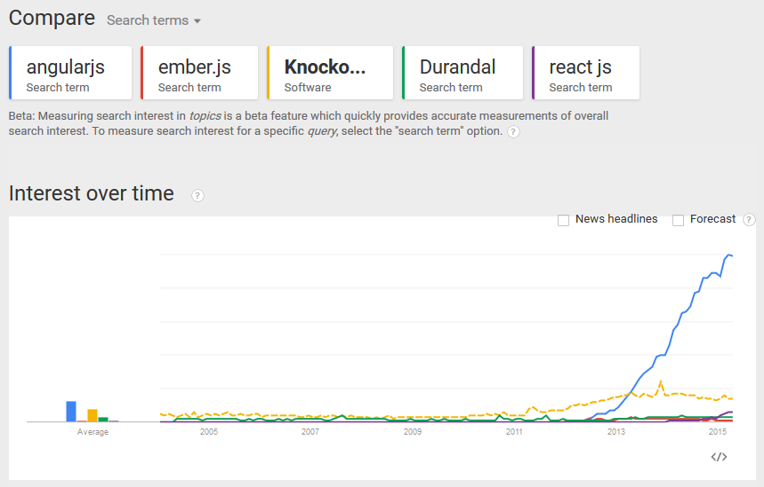
Angular – compared to other frameworks
Angular
Notes:
Google trends

Slide 150
Angular – Hello World
Directives
<!DOCTYPE html>
<html ng-app>
<body>
<!– reference the controller -->
<h1 ng-controller="HelloCtrl">
{{hello}}
</h1>
<script src="angular.js"></script>
<script>
// define the controller
function HelloCtrl($scope) {
$scope.hello = "Hello world";
}
</script>
</body>
</html>
Expression
Notes:
Google trends

Slide 151
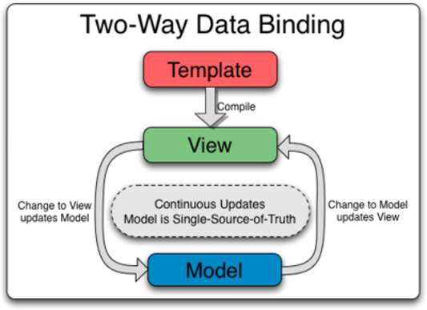
Angular Data-binding
Notes:
Google trends

Slide 152
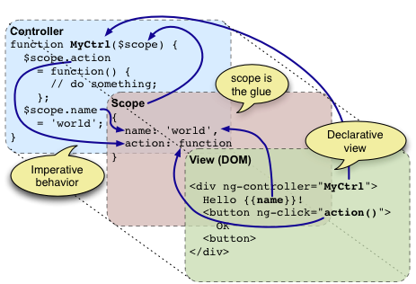
Angular $scope
Notes:
Google trends

Slide 153
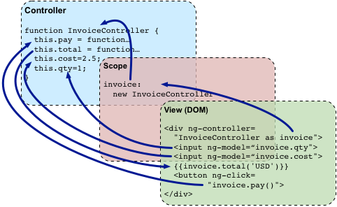
Angular using "Controller As"
Notes:
Google trends

Slide 154
$resource
var User = $resource('/user/:userId', { userId: '@id' });
User.get({ userId: 123 }, function (user) {
user.abc = true;
user.$save();
});
Notes:
https://docs.angularjs.org/api/ngResource/service/$resource

Slide 155
Restangular
Restangular.all('users').getList() // GET: /users
.then(function (users) {
$scope.user = users[0]; // { id: 123 }
});
$scope.user.getList('cars'); // GET: /users/123/cars
$scope.user.sendMessage(); // POST: /users/123/sendMessage
Notes:
https://github.com/mgonto/restangular

Slide 156
Demo #8
Restangular + Web API
Notes:
RestangularDemo

Slide 157
Restangular steps
Create Visual Studio Web App with Web API
Use NuGet to install Angular and Restangular
Manual steps
Download it: https://github.com/mgonto/restangular
Also download dependency - lodash

Slide 158
Create Angular module
app.js
create view
create controller with hard-coded data
test it

Slide 159

What is OData?
Uniform Protocol for querying/manipulating data via web
Based on RESTful patterns
Open…
Proposed by Microsoft, adopted by disparate platform vendors
Supported by broad ecosystem…
Node, PHP, Java, SQL Reporting Services, SharePoint, Windows Azure Table Storage, IMV WebSphere, DB2, Informix, Excel, Data.Js, Breeze.Js

Slide 160
OData with ASP.NET Web API
Action filter that converts query string into LINQ expression
[EnableQuery]
public IQueryable<Product> Get()
{
. . .
return _productRepo.Retrieve().AsQueryable();
}
Requires NuGet package:
Microsoft ASP.NET WebAPI 2.2 for OData 4.0

Slide 161
Calling from Angular
productResource.query({
$filter: "contains(ProductCode, 'XYZ') and Price lt 10",
$orderby: "Price desc" }, function(data) {
self.products = data;
}
});

Slide 162
Performance and Security Considerations
Use JsonIgnore attribute
Use EnableQuery sparingly
[EnableQuery(PageSize=50)]
[EnableQuery( AllowedQueryOptions=AllowedQueryOptions.Skip |
AllowedQueryOptions.Top)]
Override ValidateQuery()

Slide 163

OData not OMG Data!
Let’s reset expectations
Before – you could unintentionally expose your entire database to the world
However, Granular Access Control DOES exists!
Now – you protect/disclose what you choose…
Complete control – you can intelligently decide what to share or protect

Slide 164



Web API/OData Partnership
Like buying new vehicle. What do you need?
Basic Usage
Family Sedan – Inexpensive, ease of use?
Simply add OData expressions to URI
Get custom coding scenarios out-of-the-box
Advanced Services
Manly-Man Power Truck?
Create OData endpoints inside of Web API
Get access to powerful features
Notes:
Schedule, scope, resources

Slide 165

Basic Usage…
Inexpensive, efficient, ease of use
Helps you move beyond CRUD
Expression-based query capability
Add OData query expressions to URI
Return data with specific ordering, filtering and column (property) selection
Without writing additional code…
http://<hostname>/odata
/Products(1)/Supplier
?$Orderby=Name&$Skip=20&$Top10
Service Root
Resource Path
Query Expressions as Query String Arguments

Slide 166
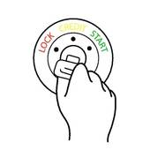

Two Easy Steps…
1) Add OData NuGet Package
2) Decorate action with [Queryable]
Converts query into LINQ expression tree
Resolved by Queryable data source
Not locked into IQueryable!
Manage query with ODataQueryOptions parameter
Best practice: Control access
OData gives you a key to keep secrets secret with the ODataValidationSettings Class

Slide 167
Demo #9
OData Query Syntax
Notes:
ODataQueryableSample

Slide 168
More Power
Need bigger engine, loaded, lots of power
Transform your Web API controller into an OData endpoint
Provides out-of-the box solutions to common Web API design challenges…
Metadata generation | Batching support
Query relationships | Page with links
Invoke operations (behaviors) | Automatic Inline Count
Specify columns (properties) | Partial Updates (Patch)
Expand related objects
Code you don’t have to write, test, maintain
Notes:
http://blogs.msdn.com/b/alexj/archive/2012/08/15/odata-support-in-asp-net-web-api.aspx

Slide 169

© 2014 Microsoft Corporation. All rights reserved. Microsoft, Windows, and other product names are or may be registered trademarks and/or trademarks in the U.S. and/or other countries.
The information herein is for informational purposes only and represents the current view of Microsoft Corporation as of the date of this presentation. Because Microsoft must respond to changing market conditions, it should not be interpreted to be a commitment on the part of Microsoft, and Microsoft cannot guarantee the accuracy of any information provided after the date of this presentation. MICROSOFT MAKES NO WARRANTIES, EXPRESS, IMPLIED OR STATUTORY, AS TO THE INFORMATION IN THIS PRESENTATION.

Slide 170
What is a Web API?
Programmatic interface to a system (an API)
Exposed as web service over raw HTTP
With REST-style communication
Expressed in JSON, XML or other format
Designed for broad reach

Slide 171
Relationships
Relationships between resources via hyperlinks
Relationships are used for containment, reference, and state transitions
Hyperlinks are followed for more details, navigation, or to perform state transitions

Slide 172
REST Architectural Elements
Components
Component | Role
Origin Server | listens for request and returns responses
User Agent | initiates a request or state transition
Proxy | represents multiple user agents to the network and clients decides whether to use it
Gateway (reverse proxy) | represents multiple origin servers to the network
Notes:
Components are defined by the role they play in the overall system.
A user agent uses a client connector to initiate a request and becomes the ultimate recipient of the response. The most common example is a Web browser, which provides access to information services and renders service responses according to the application needs.
An origin server uses a server connector to govern the namespace for a requested resource. It is the definitive source for representations of its resources and must be the ultimate recipient of any request that intends to modify the value of its resources. Each origin server provides a generic interface to its services as a resource hierarchy. The resource implementation details are hidden behind the interface.
Intermediary components act as both a client and a server in order to forward, with possible translation, requests and responses. A proxy component is an intermediary selected by a client to provide interface encapsulation of other services, data translation, performance enhancement, or security protection. A gateway (a.k.a., reverse proxy) component is an intermediary imposed by the network or origin server to provide an interface encapsulation of other services, for data translation, performance enhancement, or security enforcement. Note that the difference between a proxy and a gateway is that a client determines when it will use a proxy.

Slide 173
REST Architectural Elements
Connectors
Connector | Role
Client | initiates a resource request or state transfer
Server | listens for a request and responds
Cache | manages a store of representations for reuse for a specified length of time and can directly responds to requests for those representations
Resolver | translates a resource identifier into an address to enable 2 components to connect, e.g. DNS translates to a URL host name into an IP address
Tunnel | relays communication across a boundary, e.g. how proxies deal with SSL
Notes:
Connectors are the set of possible interfaces that a component can implement to accomplish its work.
Categorized by the role that they perform for a given component.
A component can implement multiple connectors

Slide 174
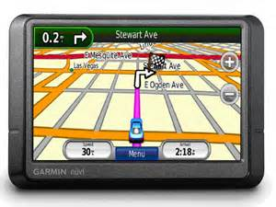
OData Provides a Map
Web API unaware of data
Container that exposes set of services
Passes data as opaque blobs
OData exposes a data model
Based on the Entity Data Model (EDM)
Imposes structure around the opaque blob – data model
Exposes metadata to client for navigation

Slide 175
Web API
OData Service
Independent
EDM
Approaches
Shared

Slide 176

Three Easy Steps…
Create EDM – Defines object model
Configure OData route
Create OData controllers
ODataConventionModelBuilder modelBuilder = new ODataConventionModelBuilder();
modelBuilder.EntitySet<Movie>("Movies");
IEdmModel model = modelBuilder.GetEdmModel();
config.Routes.MapODataRoute(routeName: "OData", routePrefix: "odata", model: model);
public class MoviesController : ODataController{...}

Slide 177
Demo #2
OData Service
Show EDM Creation
Show OData Controller
Notes:
OData4MSDN > Service
WebApiConfig.cs
ProductsController

Slide 178

OData to the Rescue
EDM mapping capability…
Emits metadata object model
Client queries model and generates service proxy classes
Exposes model schema
Enables object usage – define actual methods
Translates method calls into Http requests
OData provides Service Object Model
Client
Object Model
Web API
OData
Client Layer
Service Layer

Slide 179
Demo #3
Service Discoverability
Show EDM Metadata
Demo Tooling for OData v4 metadata exchange
Notes:
ODataModelAliasing

Slide 180
OData Attribute Routing
Move beyond convention-based routing
Custom routes provided by OData Route attribute
Simplifies routing process
More efficient routes
Eases previous limitation on naming Actions

Slide 181
Demo #4
Attribute Routing
Traverse a Parent-Child-Grandchild relationship
Pull Product Ratings from Supplier Controller
Notes:
OData4MSDN > Service
SuppliersCOntroller

Slide 182
OData Functions
When CRUD is not enough, you can execute service-based operations…
Business logic
Complex transactions
Processing data not exposed by a resource
Wraps behavior around data model
Map to single entity, collection or service itself
Define input parameters and return values
Ultimately maps to controller action method

Slide 183
Demo #5
Support for Functions

Slide 184
Model Aliasing
Change names of entities and properties
Meaningful/intuitive names
Consistent naming convention
Hide data when necessary
Two options…
(Near-identical to Entity Framework CodeFirst workflow)
Apply with EDM model builder
Or apply DataContract
Ease of use, simplification, flexibility

Slide 185
Demo #6
Model Aliasing
Show both implicit and explicit aliasing

Slide 186
Query Restriction
Out-of-the-box solution
Intelligent design: You decide what to allow
Granular control over results
Violation generates HTTP 400 and detailed error message
Query Operation | Attribute Restriction | Fluent Extension Method Restriction
Sorting | [Unsortable] | .IsUnsortable()
Filtering | [NonFilterable] | .IsNonFilterable()
Expanding | [NotExpandable] | .IsNotExpandable()
Navigation | [NotNavigable] | .IsNotNavigable()

Slide 187
Demo #7
Query Restriction
Notes:
ODataQueryLimitationsSample

Slide 188
Thank you!

